Slide 1
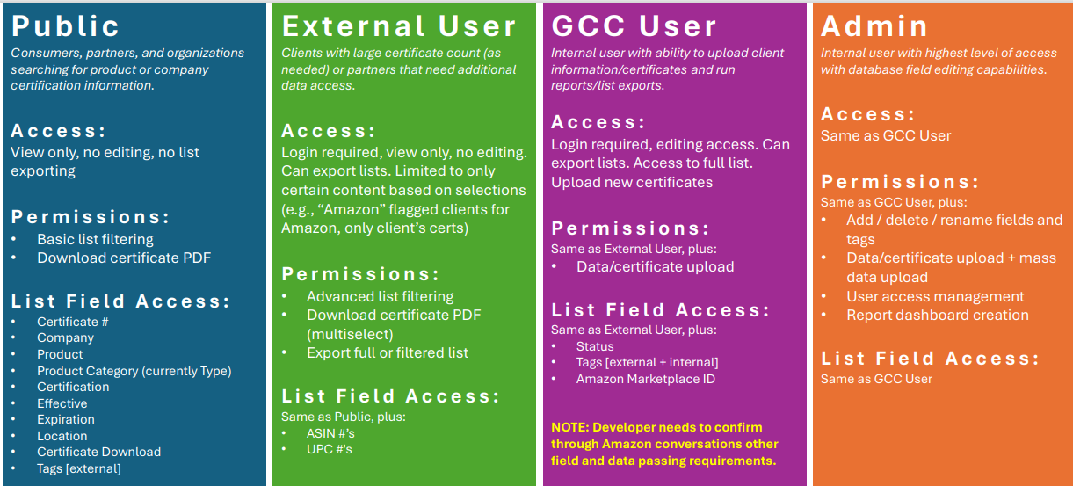
Security – Roles and Permissions

Slide 2
Requirements
Improved UI / UX and enhanced search capabilities
Allow for multiple ASINs, UPCs, and tags per cert
  Ability to pull count/number for ASINs, UPCs per cert
External and internal fields and tags*
Filtering, sorting*, export (data + cert PDFs)
Download multiselect (ability to download multiple certs at once)
API (Amazon, Mindful Materials, Ecomedes, Toxnot, etc.)
Field addition / maintenance
Customizable dashboard
Automatic public view archive when expiration date is past (keep with updated status to ‘Expired’, do not delete record, expired should be available to users only not public)
Suggest UPC (vs SKU which is listed throughout prior doc)
Saved page history (as you navigate and click on options) – open new tab when selecting product/cert
Database website tracking (visits/page views, unique visits, time of page, downloads) – Google Analytics reporting

Slide 3
Requirements
Cert import system UI
  Fields and cert PDF upload process / interface
Standard DB table fields
  [external] Certificate #, Company, Product, Product Category, Certification, Effective, Expiration, Location, Certificate Download, Tags [external]
  [internal additional] Tags [external + internal], ASIN #’s, UPC #'s, Status, Amazon Marketplace ID
Filter Options
  o Search bar (with ‘Clear filters’ option like SCS has)
  Need ability to have different levels within filter categories (see SCS example – Furniture > Seating > Lounge)
  [external] Product Category, Certification, Company, Location (country), Tags [external]
    External Tag Examples: LEED, LBC, APR, Revinylze
  [internal additional] Tags [all], Status
• User access types and maintenance

Slide 4
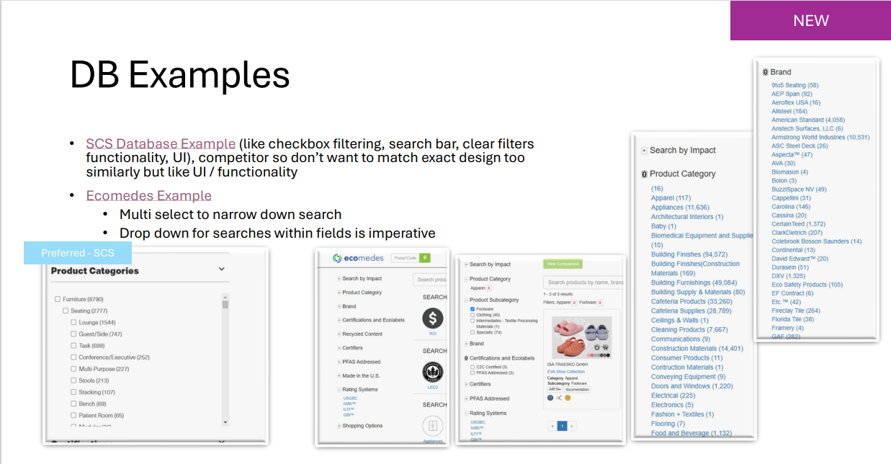
DB Examples

Slide 5
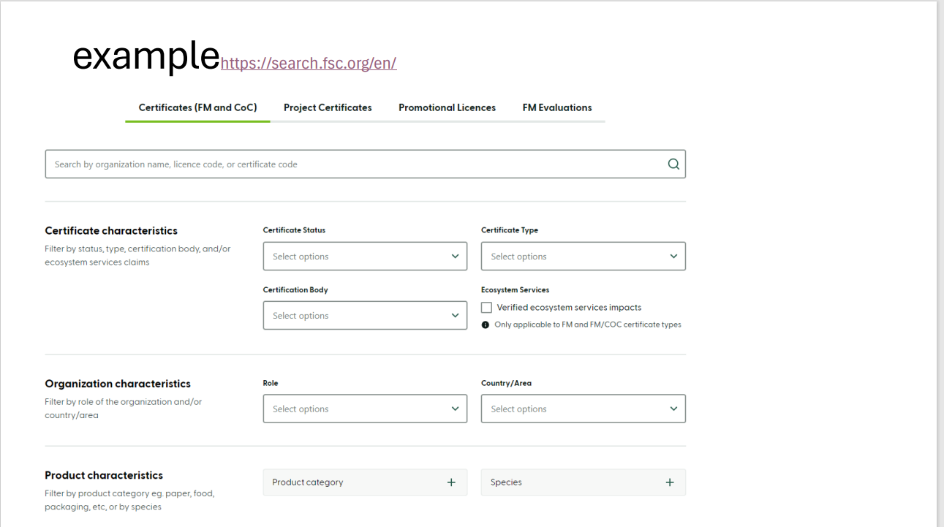
UI Examples

Slide 6
Project Status
Design and Mockups are in progress – will send over drafts early next week (Monday – Tuesday)

Slide 7
Mockups
Mockups will include
  database structure
  API Integration with Amazon
  UI Design and Search

